Slide 1
Employee CHURN RATE PREDICTION USING PREDICTION ANALYTICS

Slide 2
CONTENTS
Business Problem ……………………………………………………………………. 03
Introduction ……………………………………………………................................... 04
Column Description ………………………………………………………………….. 06
Five Point Summary …………………………………………………………………. 07
Univariate Analysis of Numerical Column ………………………………………….. 08
Features of Univariate Analysis ……………………………………………………… 10
Bivariate Analysis ……………………………………………………………………. 11
Correlation Matrix …………………………………………………………………… 12
Pairplot ........................................................................................................................... 13
Data Preprocessing …………………………………………………………………... 14
Transformation Technique of Numerical Column ………………………………….. 15
Statistical Test ………………………………………………………………………. 16
Base Model Creation ……………………………………………………………….... 17
Model Creation - Random Forest Algorithm ………………………………………... 19
Model Deployment ………………………………………………………………….. 22
Conclusion …………………………………………………………………………... 23

Slide 3
BUSINESS PROBLEM
A leading organization's business had been increasing quite well over the
past. But, there has been slowdown in terms of growth.
To predict, why best and most experienced employees are leaving based on
the given profile.
HRM Planning is very important for the companies to make sure the
continued retention of the high performers with the best talent.

Slide 4
INTRODUCTION
The main objective of Employee churn rate prediction is to build a model to predict whether employee has been left or not by using historical data . By using the above historical data we will reduce employee left rate by analysing why employee has been left by which factor are done by using EDA method. We will discuss the EDA method in the below slide.
Churn is expensive, and incremental improvements will give significant results. It will help us in designing better retention plans and improving employee satisfaction.
High employee turnover can have significant implications for an organization, including increased recruitment costs, loss of knowledge and expertise, decreased team morale, and potential negative effects on company performance. Identifying factors contributing to employee churn and predicting potential departures can help organizations take proactive measures to retain valuable talent.

Slide 5










INTRODUCTION
Attributes
Satisfaction level
Work Accident
On the left
Numerical Attributes
Last Evaluation
Promotion Last_5years
Number Project
Salary
On the right
Categorical Attributes
Average Monthly_Hours
Department
Target Variable
Left
Time_Spend_Company
Left

Slide 6
COLUMN DESCRIPTION
satisfaction_level: It is the employee satisfaction point, which ranges from 0–1.
last_evaluation: It is evaluated performance by the employer, which also ranges from 0–1.
number_projects: How many numbers of projects are assigned to an employee?
average_monthly_hours: How many average numbers of hours are worked by an employee in a month?
time_spent_company: time_spent_company means employee experience. The number of years spent by an employee in the company.
work_accident: Whether an employee has had a work accident or not.
promotion_last_5years: Whether an employee has had a promotion in the last 5 years or not.
sales: Employee’s working department/division.
Salary: Salary level of the employee such as low, medium, and high.
left: Whether the employee has left the company or not.

Slide 7
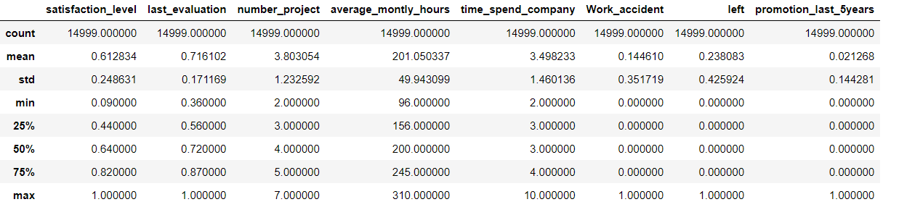
FIVE POINT SUMMARY

Slide 8
UNIVARIATE ANALYSIS OF NUMERICAL COLUMN
Satisfacation level:
In the satisfaction level, no outliers are observed in the provided dataset. The range is evident, spanning from
0 to 1, indicating a left-skewed distribution. To achieve a more normal distribution, we plan to apply the Box-Cox transformation technique.
last_evaluation :
There are no outliers in the last_evaluation data. The values range from 0 to 1, reflecting a left-skewed distribution. To attain a more normal distribution, we intend to apply the Box-Cox transformation technique.
number_project:
The number_project variable exhibits no outliers in the provided dataset, with values ranging from 2 to 7. This variable follows a normal distribution.
average_montly_hours:
The variable falls within the range of 100 to 300 and does not display a normal distribution. To address this, we plan to apply the Box-Cox transformation technique for normalization.
time_spend_company:
The "Time_spend_company" variable demonstrates a distribution spanning from 2 to 10, displaying a normal distribution. To address potential outliers, we plan to utilize the IQR (Interquartile Range) method. Additionally, a Box-Cox transformation has been implemented to further reduce outliers.

Slide 9
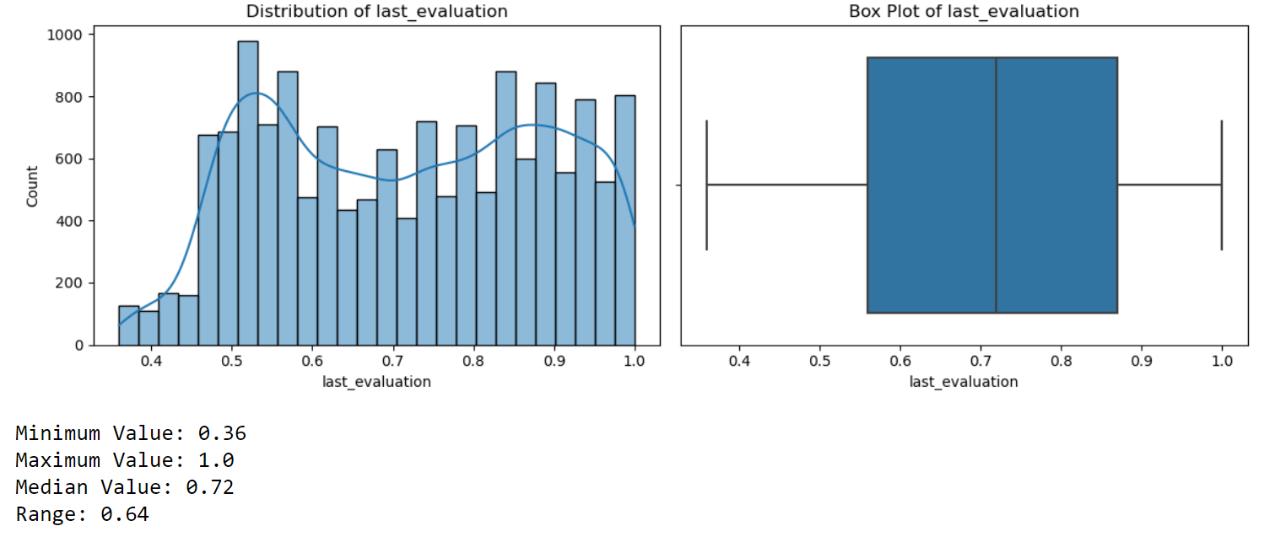
UNIVARIATE ANALYSIS OF NUMERICAL COLUMN
The sample output is shown as the below slide.

Slide 10
FEATURES OF UNIVARIANT ANALYSIS
The number of employees left is 23 % of the total employment.
A decidedly less number of employee get the promotion in the last 5 year.
The sales department is having maximum no.of employee followed by technical and support
Most of the employees are getting salary either medium or low.

Slide 11
BIVARIANT ANALYSIS(CORRELATION MATRIX)
Satisfaction Level and Last Evaluation:
There is a weak positive correlation (0.11) between satisfaction level and last evaluation. This suggests that employees with higher satisfaction levels tend to have slightly higher evaluations.
Satisfaction Level and Average Monthly Hours:
There is a weak negative correlation (-0.02) between satisfaction level and average monthly hours. This indicates that, on average, employees with higher satisfaction levels might not necessarily work more hours.
Satisfaction Level and Time Spent in the Company:
There is a very weak positive correlation (0.001) between satisfaction level and time spent in the company. The correlation is almost negligible, suggesting no significant linear relationship between these variables.
Last Evaluation and Average Monthly Hours:
There is a very weak positive correlation (0.34) between last evaluation and average monthly hours. This suggests that employees with higher evaluations might tend to work slightly more hours.
Last Evaluation and Time Spent in the Company:
There is a very weak positive correlation (0.13) between last evaluation and time spent in the company. Again, the correlation is weak, indicating that higher evaluations are only slightly associated with longer tenure.
Average Monthly Hours and Time Spent in the Company:
There is a very weak negative correlation (-0.02) between average monthly hours and time spent in the company. This suggests that, on average, employees who spend more time in the company might not necessarily work more hours.

Slide 12
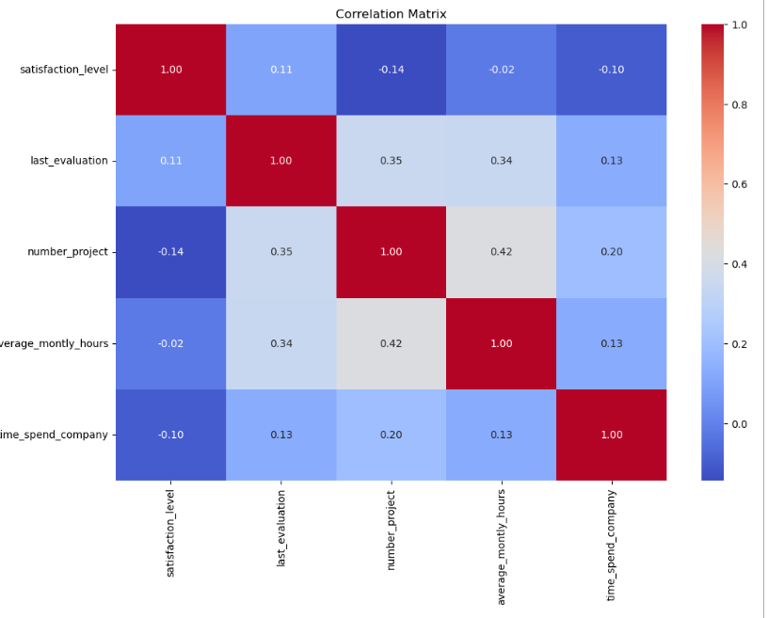
Last Evaluation and Average Monthly Hours: There is a very weak positive correlation (0.34) between last evaluation and average monthly hours. This suggests that employees with higher evaluations might tend to work slightly more hours. Last Evaluation and Time Spent in the Company: There is a very weak positive correlation (0.13) between last evaluation and time spent in the company. Again, the correlation is weak, indicating that higher evaluations are only slightly associated with longer tenure. Average Monthly Hours and Time Spent in the Company: There is a very weak negative correlation (-0.02) between average monthly hours and time spent in the company. This suggests that, on average, employees who spend more time in the company might not necessarily work more hours.
CORRELATION MATRIX

Slide 13
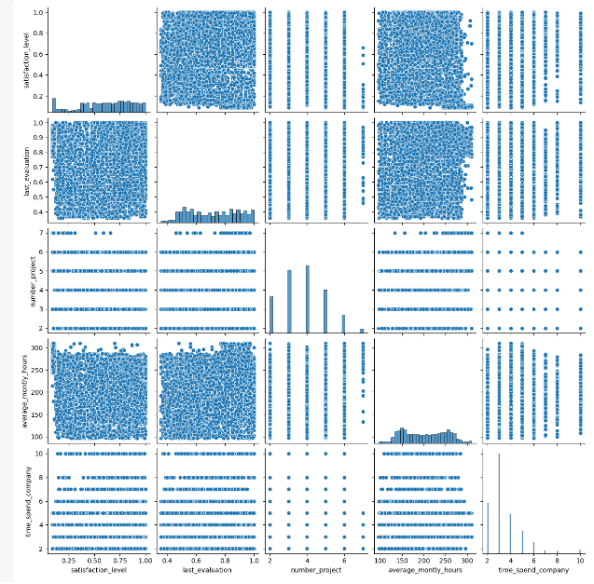
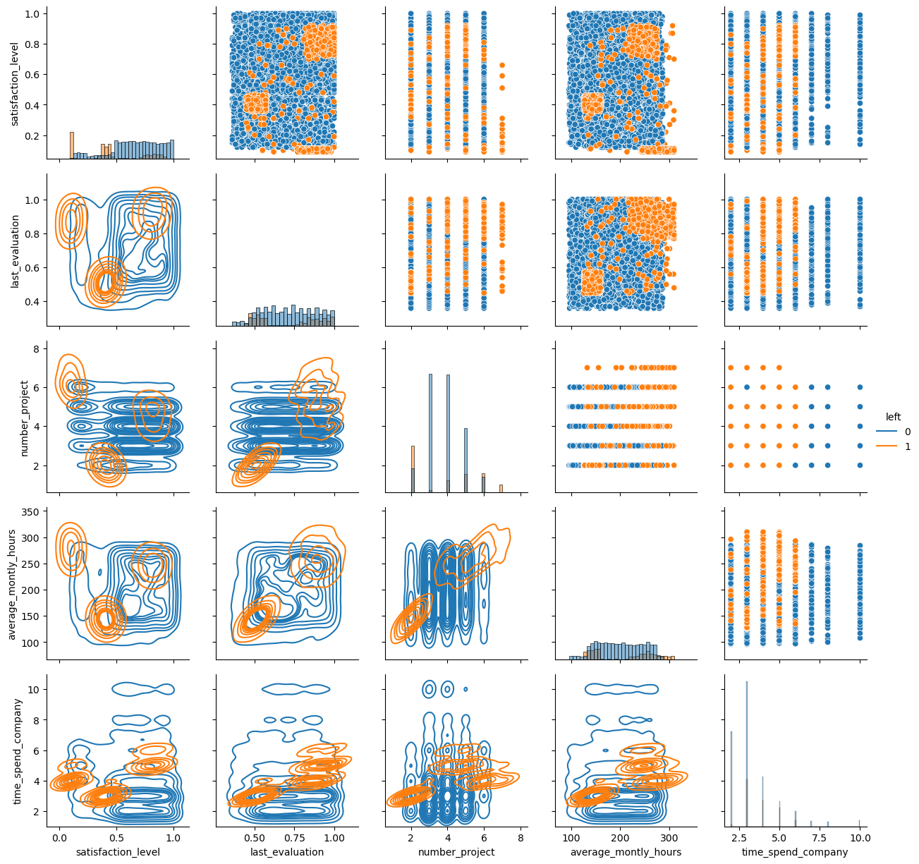
PAIR PLOT

Slide 14
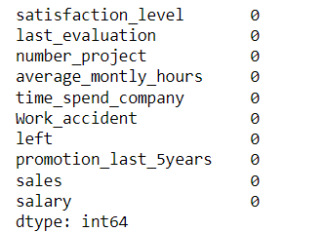
DATA PREPROCESSING
Here the given data does not contain any missing value, so we can directly proceed with the next step.

Slide 15
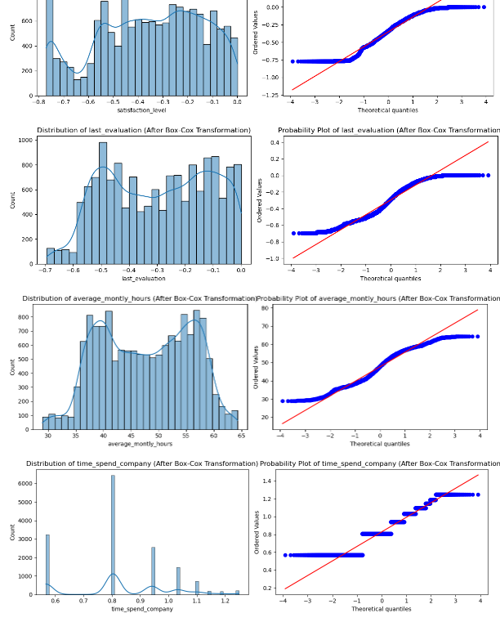
TRANSFORMATION TECHNIQUE FOR THE NUMERICAL COLUMN
Hence we are applying transformation technique like box cox transformation for the numerical variable like satisfication_level, last_evaluation and average_monthly_hours, time_spend_company to become normally distributed

Slide 16
STATISTICAL TEST
As per the below t test performed , there is a relationship between
satisfication level and last evaluation.
satisfaction_level and number_project.
last_evaluation and average_monthly_hours.
last_evaluation and time_spend_company.
number_project and average_monthly_hours.
number_project and time_spend_company.
average_monthly_hours and time_spend_company.
As per the Chi-squared test performed, we are able identify there is a relationship between
Work_accident and left.
Work_accident and promotion_last_5years.
Work_accident and sales.
left and sales, salary.
promotion_last_5years and sales, salary.
sales and salary
There is no relationship between left and promotion_last_5years.

Slide 17
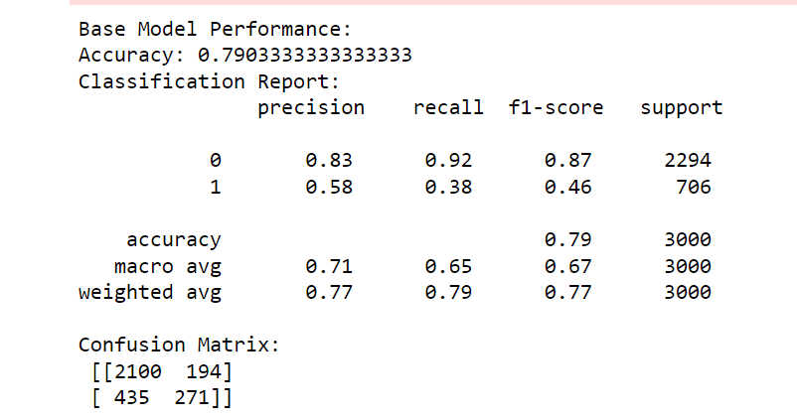
BASE MODEL CREATION
In Model creation ,we are creating a base model name as logistic regression and with the help of model we will build and predict the accuracy scores .

Slide 18
The base model yields an average accuracy, we plan to explore various machine learning algorithms to identify the one that provides a superior prediction score. Once we identify the algorithm with the best performance, we intend to conduct feature extraction methods using that optimized model to enhance predictive accuracy.Upon evaluating different model functions, the Random Forest classification algorithm demonstrated outstanding performance, achieving an accuracy of 98.83%, surpassing other methods. Considering this, we have chosen to utilize the Random Forest algorithm for our predictive tasks
The Random Forest classification method, utilizing transformed features, achieved an impressive accuracy of 98%. Notably, variables such as satisfaction_level, last_evaluation, number_project, average_monthly_hours, and time_spend_company demonstrated significant relationships with the target variable. It's important to note that reducing these variables could potentially result in a decrease in the accuracy of the model.

Slide 19
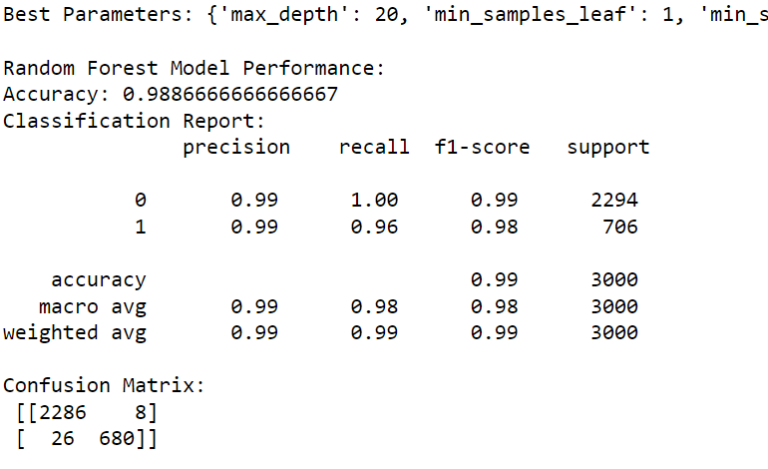
MODEL CREATION
After applying box cox transformation to reduce the skewness, random forest algorithm provide 98.83 % accuracy.

Slide 20
RANDOM FOREST ALGORITHM
Accuracy (0.9883)
Accuracy is the ratio of correctly predicted instances to the total instances. In this context, an accuracy of 0.9883 means that the model correctly predicted whether an employee left or not about 98.83% of the time. Precision (0.9884):
Precision is the ratio of correctly predicted positive observations to the total predicted positives. A precision of 0.9884 indicates that when the model predicts an employee will leave, it is correct about 98.84% of the time. Recall (0.9618):
Recall is the ratio of correctly predicted positive observations to all observations in the actual class. A recall of 0.9618 means that the model is able to capture approximately 96.18% of employees who actually left. F1 Score (0.9749):
F1 Score is the harmonic mean of precision and recall, providing a balanced measure. An F1 Score of 0.9749 suggests a good balance between precision and recall, considering both false positives and false negatives. ROC-AUC Score (0.9908):
ROC-AUC evaluates the model's ability to distinguish between classes, considering the trade-off between true positive rate and false positive rate. A ROC-AUC Score of 0.9908 indicates a high discriminatory power of the model, with a strong separation between employees who left and those who didn't. In summary, the model appears to perform very well based on these metrics. It demonstrates high accuracy, precision, recall, and F1 Score, indicating effectiveness in predicting employee churn. The ROC-AUC Score further reinforces the model's ability to discriminate between positive and negative instances. However, it's crucial to consider the specific context and business requirements when interpreting these metrics.

Slide 21
The selected models, trained on the identified important features, demonstrate excellent performance in predicting employee churn. Random Forest and Decision Tree models achieved perfect scores, while Gradient Boosting, XGBoost, and LightGBM also exhibited high accuracy and predictive capabilities.. Further hyperparameter tuning and optimization can be performed to fine-tune the selected models.
All models (Random Forest, Gradient Boosting, XGBoost, and LightGBM) demonstrate high performance with accuracy around 98.9%. Precision, recall, and F1 score are also high, indicating a good balance between identifying positive cases and avoiding false positives. The ROC-AUC scores are consistently high, indicating strong overall model performance in distinguishing between classes. In conclusion, the models have been effectively tuned and perform well on the given task. The choice of the best model may depend on specific considerations such as interpretability, training time, or other domain-specific requirements.

Slide 22
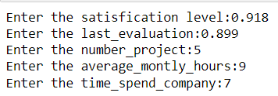
MODEL DEPLOYMENT
The following code showcases the prediction functionality of the model using specified values for
features such as satisfaction_level, last_evaluation, number_project, average_monthly_hours and
timespend_company. This model is capable of determining whether the employee has left or not based
on the provided input.

Slide 23
CONCLUSION
The dataset contains 24% of ‘left’, which is 3,571 employees.
Three conditions that affect ‘resigned’ are:
low or moderate satisfaction (satisfaction_level < 47%)
have a workload of 3 or more projects (number_project >= 3 projects) and
their performance being evaluated at least 58% (last_evaluation >= 58 %)
Three conditions that are not affect ‘resigned’ are:
first condition: satisfaction level >= 47%
second condition: time_spend_company < 5 years
third condition: last_evaluation < 81%

Slide 24


Slide 25
THANK YOU

